Slide 1
Take Home Final: Team Trainer Program
Isabella Eaton
CS1050 (T/R, 12-1:50p)
MSU Denver

Slide 2
Project Overview
Key Features
User (trainer) uploads a file containing a list of athlete data.
User receives a comprehensive overview including:
Team name
Athlete name, BMI, BMI category, and maximum heart rate
Athletes outside normal BMI range
Average max heart rate
Athlete with the highest max heart rate
Shortest and tallest athlete
Results are written and saved to a file for user to keep.
What problem(s) does this project solve?
This program is designed for Trainers of athlete teams to be able to use basic athlete data (name, weight, age, height) to to receive a comprehensive team and athlete analysis that can be used for a variety of applications such as progress monitoring and optimizing training regimens.

Slide 3
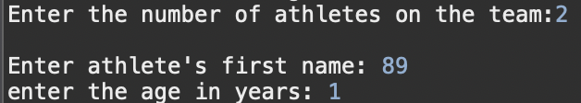
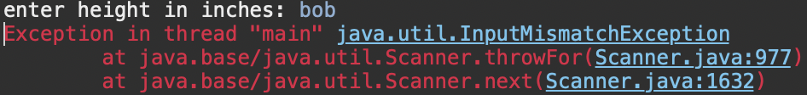
UML in PI01 and PI02: an overview of iteration changes
PI 01 UML
Iteration 01 pros
Project01Trainer
+ void displayProgramOverview() + int getPositiveInteger(Scanner userInput, String questionPrompt) + double getPositiveDouble(Scanner userInput, String questionPrompt) +void enterAthleteData(Scanner, userInput, int athleteCounter, String [] athleteFirstNames, double[] athleteBMI, double[] athlete MHR) + String getAthleteNames(Scanner userInput) +double getAthleteBMI(double athleteWeight, double athleteHeight) +double getAthleteMHR(int athleteAge) +void getBMICategory(double bmi) +void getBMIOutliers(int athleteCount, double[] athleteBMI, String[] athleteFirstNames) + void getAverage(double[]athleteMHR, int athleteCount, String questionPrompt) +void findMaxIndex( double[] athleteMHR, String[]athleteFirstNames, int athleteCount, String questionPrompt) + void showAboveorEqual (int athleteCount, doublemaxValue,double[]athleteMHR, String[]athleteFirstNames, String questionPrompt) +void continueProgram(Scanner userInput, String questionPrompt, String[] athletefirstNames, double[] athleteMHR, int athleteCount) + char getValidChar(Scanner userInput) + void getTrainingHR (Scanner userInput, int athleteCount, String[]athleteFirstNames, double[]athleteMHR)
User Interaction: user can enter athlete data on their own
Iteration 01 cons (to resolve in iteration 02)
Team size: team size can be altered each time program is run, not set.
Easy to crash: program will crash if char is entered for a request for a numerical value, lacks an escape if incorrect data is entered.
Methods: all methods under one class. Many methods have similar parameters or are void (could benefit from classes instead), lacks adherence to SRP and DRY.

Slide 4
UML in PI01 and PI02: an overview of iteration changes
Iteration 02 changes
Class 1
Class 2
Project02Trainer
+ main method + void teamSetUp(String fileName, Team team) void runAnalysis(Team team) void displayProgramSummary()
Athlete
- String name - double weight -double height - int age
+ Athlete(String name, double weight, double height, int age) + String getName() + double getHeight() + double calculateBMI() + String determineBMICategory() + int calculateMaxHeartRate() + void displayAthleteAnalysis() //Displays the athlete’s name, BMI, BMI category, max heart rate.
Implementation of classes: separate classes for general setup & analysis, the team, and individual athlete.
Remove keyboard input: user will now have a file read into the program containing all necessary athlete data. If file is not found, a message is displayed.
User can now save output of program.
Importance of changes
Multiple classes help support SRP by ensuring each class has its specific thematic role.
Class 3
Team
-String teamName -Athlete[] athletes -int athleteCount
+ Team(String teamName, int maxAthletes) +String getTeamName() +int getAthleteCount() +void addAthlete(Athlete athlete) +void displayAthleteResults() +void displayAthletesOutsideNormalBMI() +double calculateAverageMaxHeartRate() +void displayAthletesAboveAverageMHR(double avg) + void displayHighestMHR() + void displaySmallestLargestHeight() + void writeAthletesToFile(String fileName)
Classes supports DRY by removing any repeated calculations and condensing them into the methods for the class.
Set team size in program ensures consistent analysis across multiple teams. Ability to save report is beneficial for program usability.

Slide 5
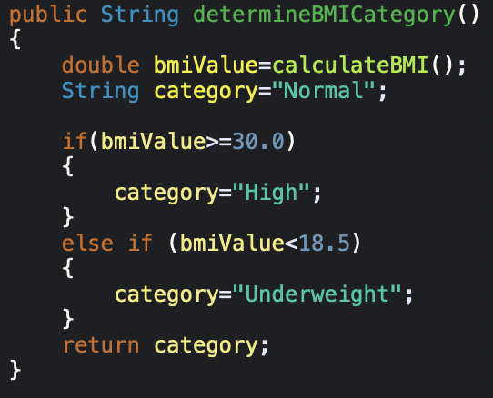
Control structures & application: Decision structures
Multi-way if/else statements
Used when multiple conditions are true at the same time for one variable.
Signs to use: when >= <= is involved.
Given:
bmiValue=double
Category=“Normal”
Application in PI02: Used to efficiently assign BMI category to an athlete (following DRY)
bmiValue >=30.00
bmiValue < 18.5
Category=“High”
Category=“Underweight”
bmiValue is not >=30.00 OR <18.5
-program ignores if/else statements
Category=“Normal”
PI02 lines 198-211
Flowchart of method

Slide 6
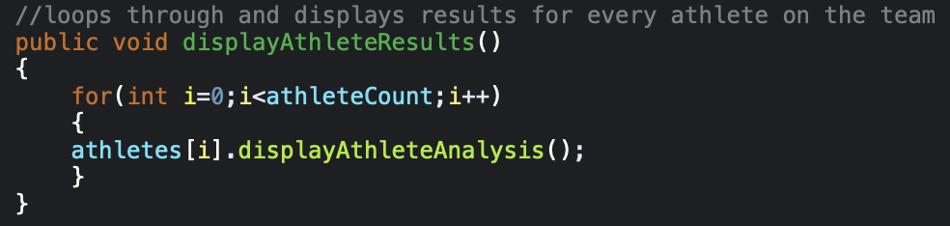
Control structures & application: loops
For loop statements
Repeats an action a predetermined number of times based on the count parameters.
Signs to use: when you know how many times you would like to execute the same line of code, when you would like to display items in an array.
Application in PI02: Used to efficiently display athlete analysis (following DRY- “don’t repeat yourself”)
Example: PI02 lines 297-202
Initialize & assign int I to 0 (counting variable)
Repeat loop while value of I is less than the value of athleteCount (also an int)
Increase value of I AFTER each loop
Begin for loop
Parameters/condition for the loop to continue
What action is being repeated/looped
In the athlete array, at index location i
Carry out displayAthleteAnalysis

Slide 7
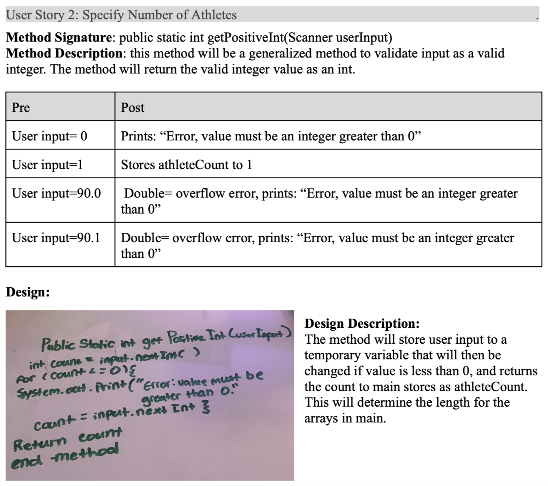
Agile software development
Test-cases and Their Benefits
Example: PI01
Breaking down a problem:
Noticed: Multiple user stories in PI01 need integer inputs, need to validate this input.
Solution: make a method for validating integer inputs, helps contribute to DRY, enhances readability,
Test cases: should include your precondition, a positive or correct test case and negative or incorrect test case.
Helps understand and plan for errors when coding.
Sets foundation for design outline using pseudocode.
Positive test case: “what entry would result in your intended output?”
Precondition: “What do you need defined for your task?”
Postcondition: ”what is your goal or expected output”
Negative test case: “What incorrect entries would need to be redirected?”

Slide 8
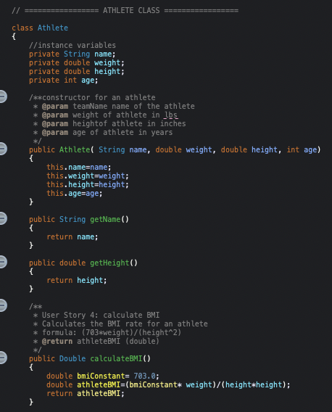
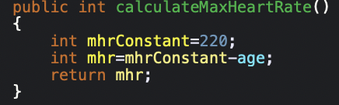
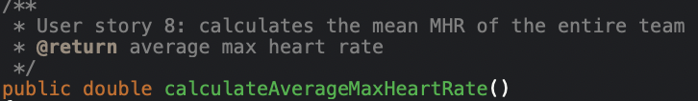
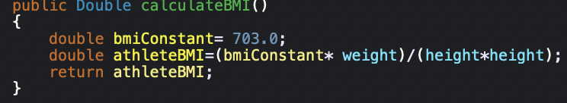
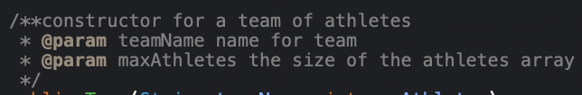
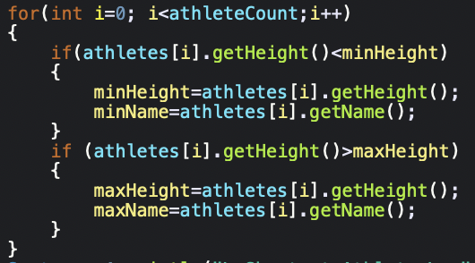
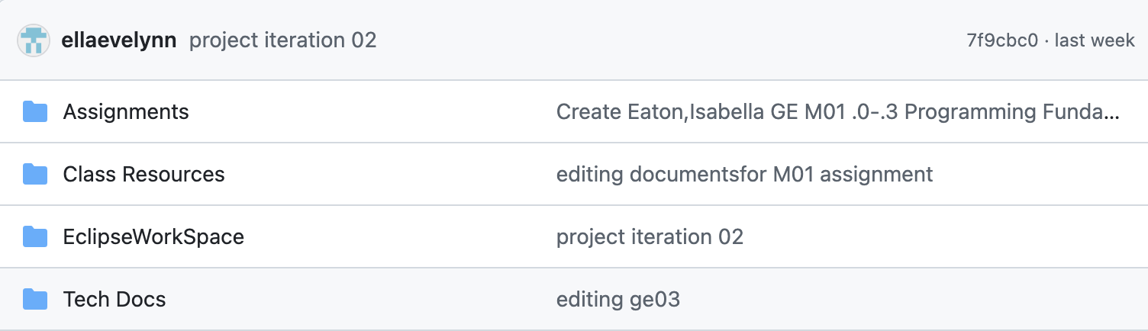
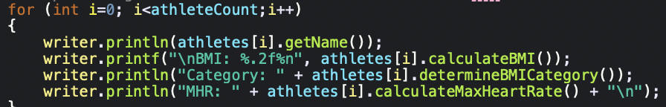
Quality coding mindset (PI02)
SRP (Single Responsibility Principle)
DRY “Don’t Repeat Yourself!”
Documentation (Commenting)
“A class should only have one reason to change”(Martin, 2003)
A class should focus on one well-defined responsibility
Simplify and condense logic into reusable components in your program (methods, classes, loops)
Improves readability, and improves ease of debugging.
Javadoc commenting improves readability for classes, methods, and complex chunks of code.
GitHub commenting improves individual and team understanding in large or collaborative projects.
The core responsibility for the athlete class is to represent an athlete.
Using methods for repeating logic (repeated calculations for athlete data)
Use commenting to track parameters and/or return values.
Use commenting when committing and pushing to GitHub for personal understanding..
Using loops for repeated commands (printing array results, writing results to a file)
Example: PI02, lines 142-186 (pictured), lines 142-245 (total). Condensed in example.
Examples: PI02, lines 220-226 (calculateMaxHeartRate), 182-188 (calculateBMI), 387-399 (displaySmallestLargestHeight), 418-424 (writeAthletesToFile)
Examples: PI02, lines 324-327(calculateAverageMaxHeartRate), 258-261 (Team constructor), GitHub, @ellaevelynn “CSJavaRepos”

Slide 9
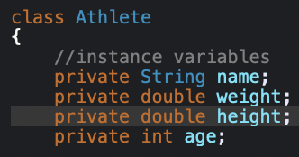
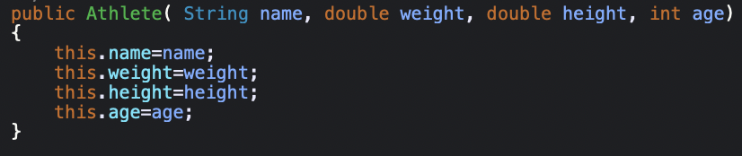
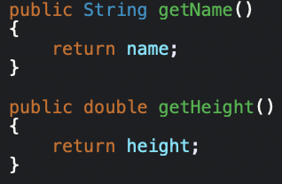
Classes and objects (I2 Athlete class)
Instance Variables
Constructors (Object Creation)
Represents state/attributes of an object.
Scope: class-level
Accessible to every method in the Athlete class.
Constructor and class name must match.
Parameters (from athlete class instance variables)
Initializes new objects.
Memory allocated for new athletes, runs code to assign specific values to this instance.
Initialize attributes (name, weight, height, age), values are default (“null”, 0.00, 0)
“Take this (name, weight, height, age) the user has provided and save it to this specific object’s permanent memory.”
PI02, lines 144-150
PI02, lines 158-164
Encapsulation (Getters & Setters)
Methods (Behavior)
Return type
method
Return type: none
Instance methods use object’s internal data (weight, height, age) to perform calculations.
Don’t need to pass parameters for instance methods.
Encapsulation: hides internal state of an object, makes all interaction happen through public methods.
Access modifier: method visible to any class
PI02, lines 236-244
Return type: int
Return action. Prompts program to exit method and output value stored in instance variable (name, height)
PI02, lines 220-226
PI02, lines 14166-175
Return type: String
PI02, lines 198-212

Slide 10
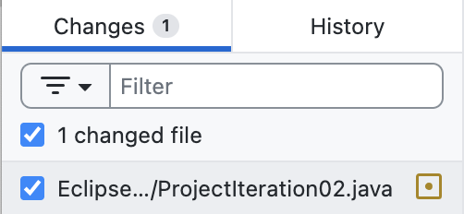




Version control, Git& GitHUb, Repositories
Version Control
Uses
Tracks and manages changes to software code or documents
Used primarily to track code changes and Tech Doc changes
Tracking changes in tech doc was incredibly helpful in tracking changes in tech doc and addition of new concepts in between quizzes
Git
used locally to track changes
To store changes locally
To store changes on GitHub
GitHub
Global resource to access code and documents stored in repository.
Repository: specialized storage system

Slide 11
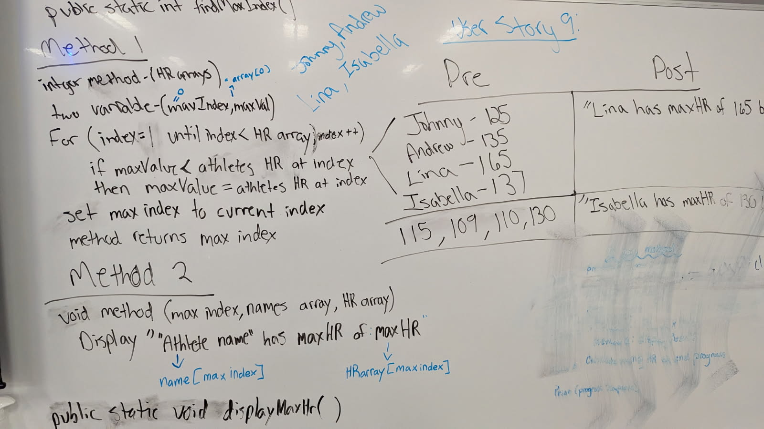
Team collaboration
Benefits of collaboration
Improves multi-approach understanding of tasks.
Improved development of communication and feedback skills.
Builds academic community
Study groups, group chats, collaboration helped a lot for PI01 test case brainstorming.
Increases confidence to ask for help.
Comparing Tech doc examples with group members at the beginning of the semester helped my team improve the readability and usability of our tech docs.
PI01 User story 9 team collaboration activity Thurs April 02, 2026
Collaborators: Johnny, Andrew, Lina

Slide 12
Debugging and testing

Slide 13
Debugging and testing

Slide 14
Design vs implementation

Slide 15
Design vs implementation

Slide 16
reflection

Slide 17
reflection

Slide 18
Sources
Martin, Robert C. (2003). Agile Software Development, Principles, Patterns, and Practices. Prentice Hall. p. 95. ISBN 978-0135974445.

Slide 19
Thank You!
Github profile (qr code)
Link to repository
Link to tech doc
Link to project iteration 1 and 2 java codes

